Slide 1
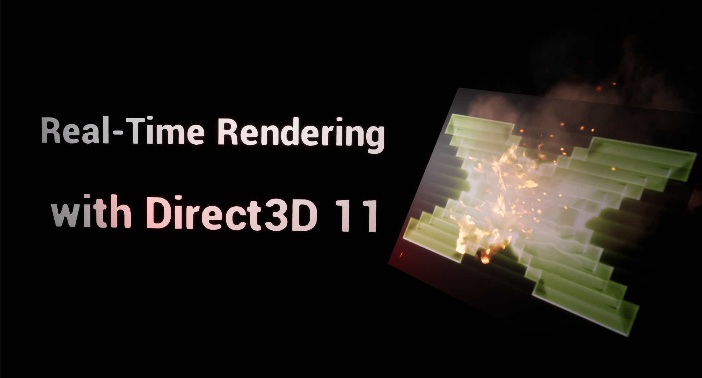
Calibri Bold 36 pt
Presenter, Calibri 20 pt, Version 00, English, Month 20XX
Internal version, Calibri Bold 48 pt

Slide 2

Part I: Introduction
Presentation created by B. Kidalka

Slide 3
What is Direct3D 11?
Direct3D 11 is a major part of the DirectX 11 SDK from Microsoft.
It is a low-level API (COM/C++) used for drawing graphic primitives like points, lines or triangles making use of the rendering hardware of modern GPUs.
It hides the different vendor specifics of GPUs from the developer and is designed for high performance rendering utilizing the massive parallel architecture of current GPUs.
Direct3D 11 can also be used for GPGPU tasks like image post-processing / filtering, applying DirectCompute shaders, introduced with this D3D version.
It is only available for Windows platforms (Win7, Win8/8.1, Win10).

Slide 4
What is Direct3D 11?
Direct3D 11 provides also an optimized CPU device (WARP device), which makes use of the vector extensions (SSEx, AVX, AVX2, …) of modern CPUs.
The development of the Direct3D feature set was mainly driven by the needs of the computer games industry, which pushes rendering demands to more and more realism, sustaining real-time frame rates of at least 60 FPS with full-HD resolution (1920 x 1080).
Beside computer games, Direct3D 11 is also used for scientific visualization, architectural visualization and product design as well as medical image visualization, CAD, 3D content creation tools and so on.

Slide 5
The DirectX SDK
Up to Windows 7, the DirectX SDK was provided as standalone SDK, which needed to be installed in addition to the Windows SDK.
The last isolated release was the June 2010 SDK, intended to be used with Visual Studio 2010.
Starting with Windows 8, the DirectX SDK is included as part of the Windows SDK, due to the increasing importance of graphics support in application development.
The relevant Windows SDK is always installed via the Visual Studio installation, beginning with Visual Studio 2012.

Slide 6
3D concepts & defined terms
Vertex
A vertex is often associated with a position in 3D space, described via a cartesian coordinate triplet (x, y, z).
In geometry it is a point where at least two lines or curves meet.
In the context of 3D APIs, it is a data structure, which can contain multiple attributes. Some Examples:
Position
Color
Texture coordinates
Normal vector …

Slide 7
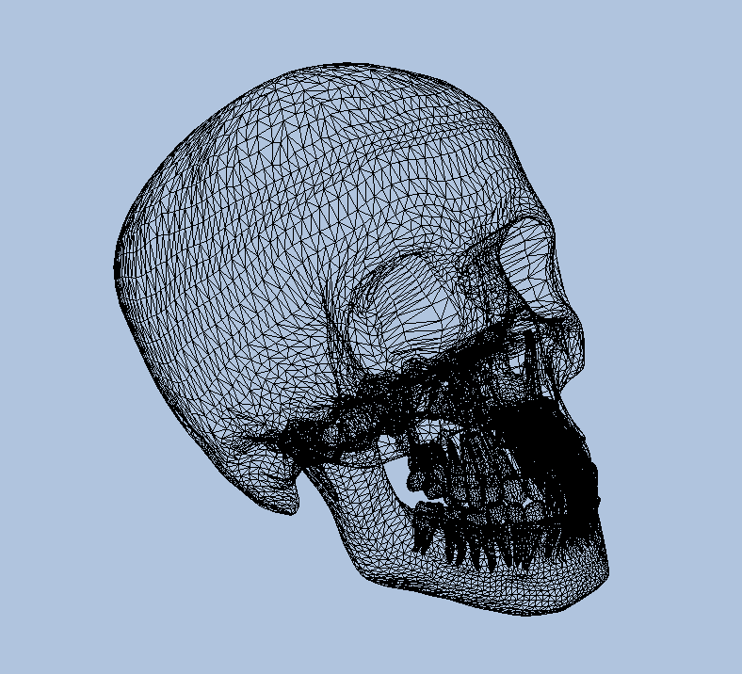
3D concepts & defined terms
Polygons, Triangles, Quads and Meshes
Multiple vertices define geometric primitives like lines, triangles, quads, line-strips, triangle-strips, etc.
The combination of geometric primitives can build more complex objects, which are described in 3D space by a so-called 3D mesh.

Slide 8
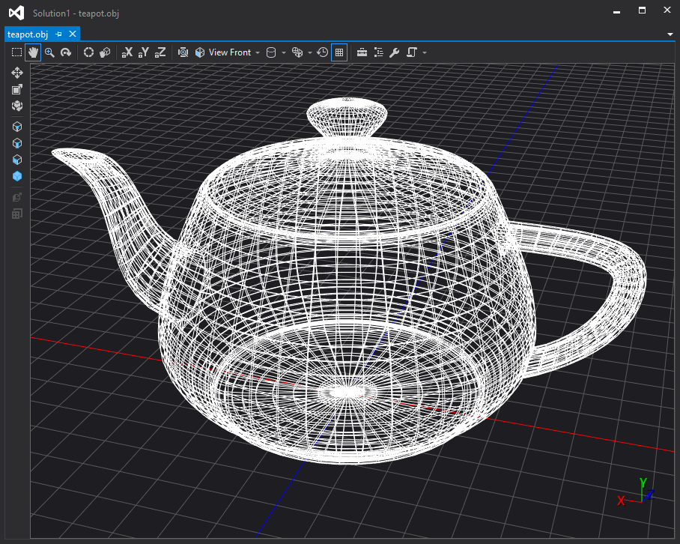
3D concepts & defined terms
Wireframe rendering
Wireframe rendering shows how a 3D mesh is “wired” together from the set of vertices / polygons.
This rendering mode is often used to show the complexity of a scene or object.
It is also very useful to unveil geometry errors, which are hard to tackle in full lit or shaded mode.

Slide 9
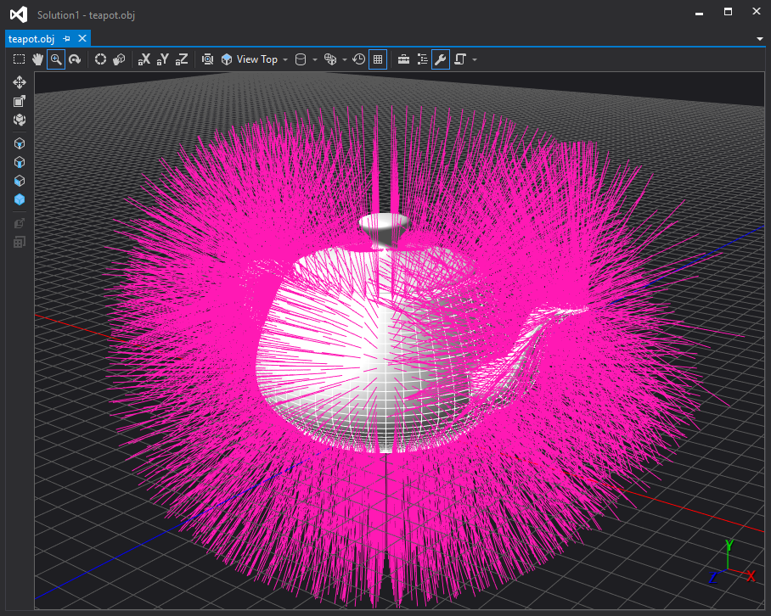
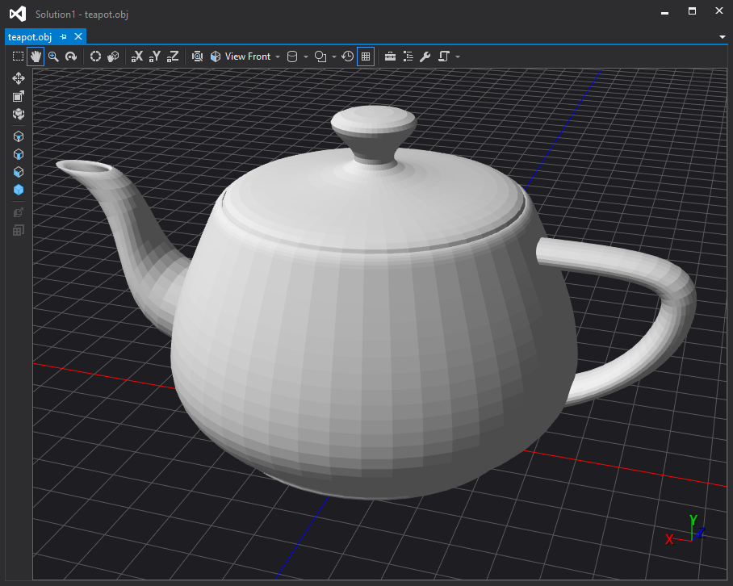
3D concepts & defined terms
Flat shaded rendering (Flat Shading)
Flat shading is the simplest form of shaded rendering.
This rendering mode uses a basic local illumination model (ambient + diffuse), which considers only the face normal vector for lighting calculation.
Vertex normals are ignored. The lit color of a polygon face will only be calculated for one pixel and applied to the complete polygon face.
This leads to an unnatural tiled look of objects, especially in case of low-poly models.
This mode is often used only for debugging purposes.

Slide 10
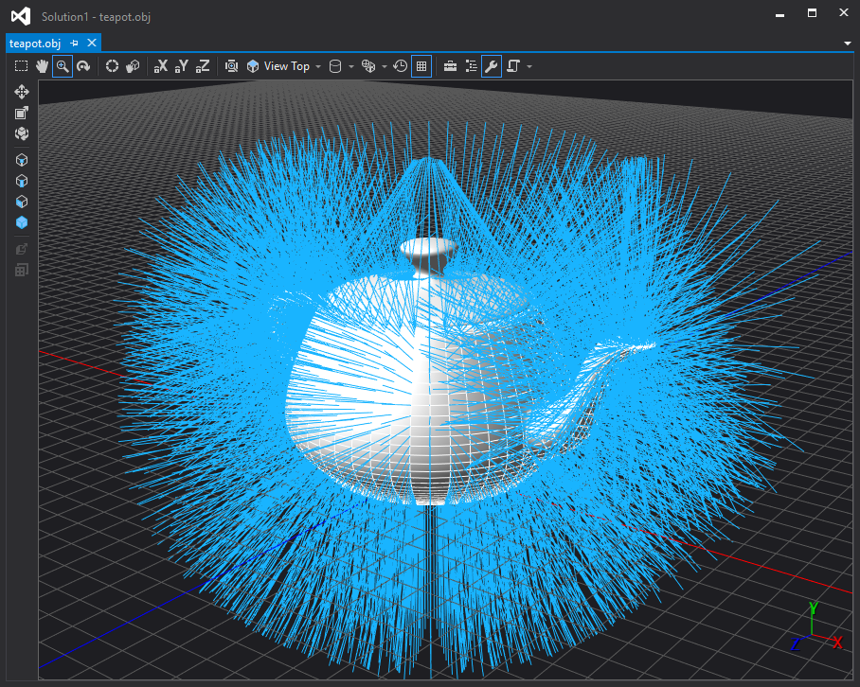
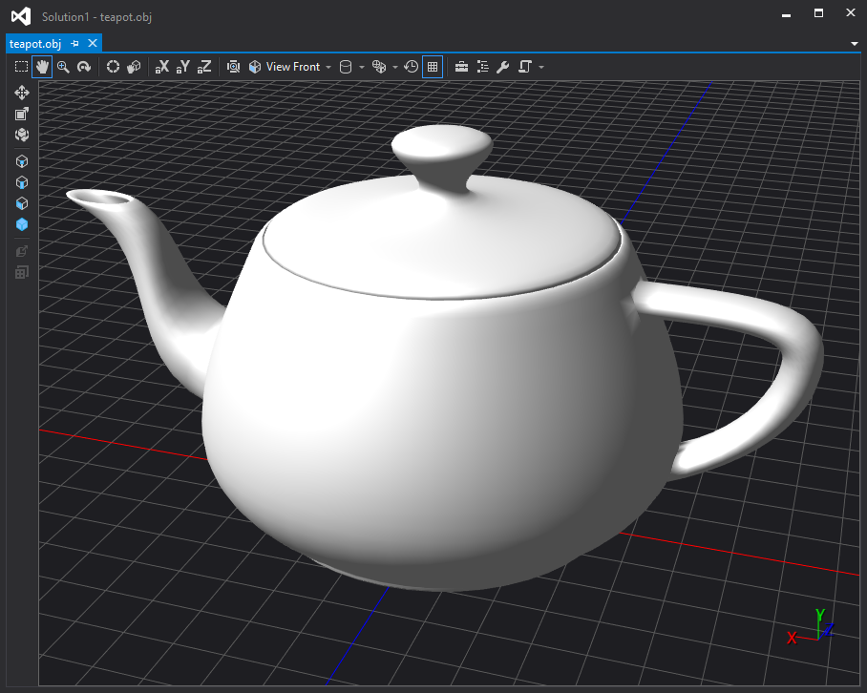
3D concepts & defined terms
Smooth shaded rendering
(Smooth Shading)
Smooth shading results in continuously changing color properties on a per pixel basis for each polygon face of an object.
Typically modes are Gouraud shading and Phong shading, which apply a local illumination model (ambient + diffuse + specular) for lighting.
Gouraud shading calculates lighting for each vertex normal and interpolates the results for all pixels of a polygon.
Phong shading uses interpolated normals for lighting calculation for each pixel to be shaded (→more precise, but also more expensive).

Slide 11
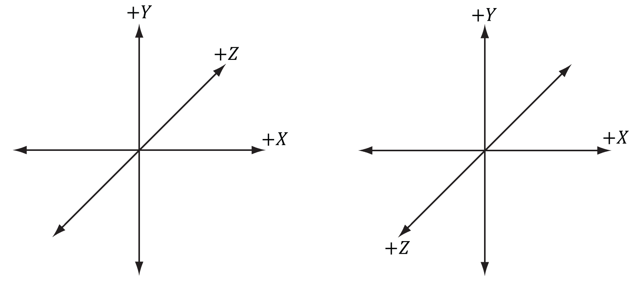
3D concepts & defined terms
Coordinate systems
In computer graphics, two types of 3D coordinate systems are used with respect to the “handedness”: Left Handed System (LHS) or Right Handed System (RHS).
LHS
RHS

Slide 12
3D concepts & defined terms
Coordinate systems
Direct3D based implementations often prefer LHS, OpenGL based applications use typically RHS.
Both major 3D APIs can work with either of the two coordinate system types.
The choice of the CS type has impact on the applied math and the rules how to define geometry (3D models/meshes).
The demo volume ray-caster presented in the second half of this session is implemented based on a Left Handed coordinate system.

Slide 13
3D concepts & defined terms
Coordinate systems – consequences of the choice for LHS
Transformation matrices are row-major aligned.
Vertex definition in clock-wise order means the respective polygon is front-face.
Clock-wise rotation angles are positive.
Matrix concatenation order (multiplication) is from left to right.
matWorldViewProj = matWorld * matView * matProj;
Performing a vector-matrix multiplication means vector is multiplied on the left (a.k.a. pre-multiplication; this is not commutative as vector is a row vector).
row vector is special matrix with dimension [1 x n] →1 row, n columns
vector-matrix mul will match if matrix has n rows e.g. [n x p], result=[1 x p] vec

Slide 14
3D concepts & defined terms
Geometric interpretation of a row-major aligned 4 x 4 matrix
Scale Vector
11 | 12 | 13 | 14
21 | 22 | 23 | 24
31 | 32 | 33 | 34
41 | 42 | 43 | 44
3 x 3 Rotation Matrix
Rotation Axis X
Rotation Axis Y
Perspective
Rotation Axis Z
Translation Vector
Global Scale

Slide 15
3D concepts & defined terms
Coordinate Space Transforms
Until a final image of a 3D scene is presented to the user, all graphic objects traverse multiple coordinate space transforms.
Local Space
World Space
Clip Space
View Space
Screen Space (2D)
[ World Matrix ]
[ View Matrix ]
[ Projection Matrix ]
Viewport Transform

Slide 16
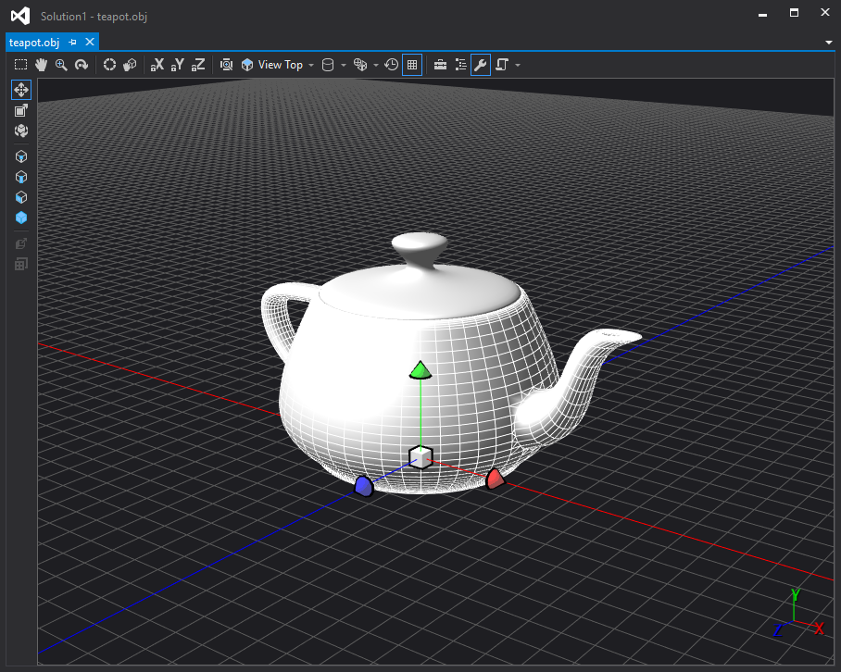
3D concepts & defined terms
Coordinate spaces: local space
Local space is the CS, where the 3D object is defined relative to its local origin.
All vertices are local to the object.

Slide 17
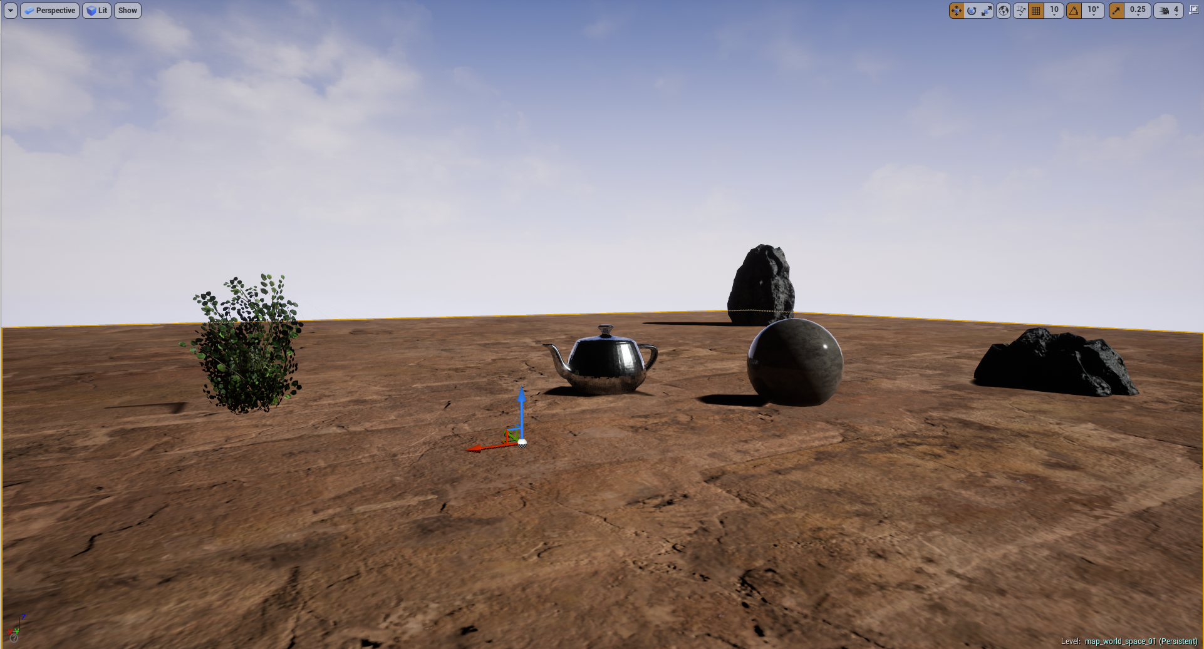
3D concepts & defined terms
Coordinate spaces: world space
World space is the CS, where the 3D object is placed in, relative to one global origin.
Multiple objects share the same global coordinate frame.
All vertices are transformed to the global CS via the world transform matrix.
The world transform matrix is often a concatenation of scaling, rotation and/or translation transforms.

Slide 18
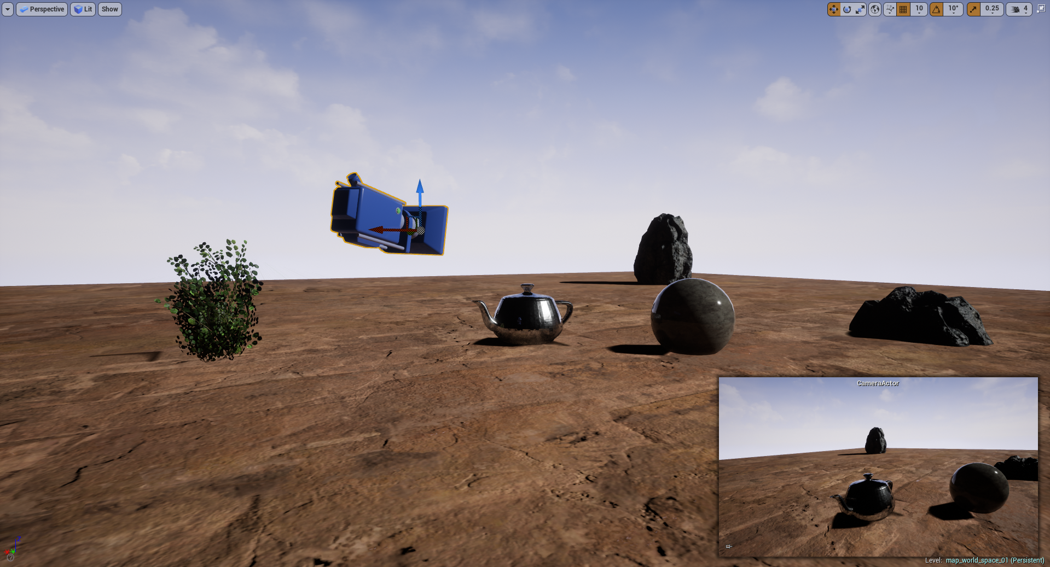
3D concepts & defined terms
Coordinate Spaces: view space
View space (a.k.a. camera space or eye space) is the CS, where the 3D object is shown from the point of view of a virtual camera or users eye-point.
The camera itself is positioned in world-space coordinates and focuses the so called “Look-At” position.
Depending on the cameras properties (world position, up-direction, look-at position) a further coordinate frame is defined: the camera space or view space.
Each object with associated vertices needs to be transformed to the view space coordinate system via the view matrix.

Slide 19
3D concepts & defined terms
Coordinate Spaces: clip space (I)
Before a complete 3D scene is finally projected onto a 2D image plane, which maps to the screen viewport, all objects are transformed to the clip space via the projection matrix.
Clip space is a normalized coordinate space, where the coordinates are within the range [-1.0 .. 1.0].
OpenGL defines the clip space unit cube for X,Y,Z in the range [-1.0 .. 1.0].
Direct3D defines the clip space unit cube for X and Y in the range [-1.0 .. 1.0] and for Z in the range [0.0 .. 1.0].

Slide 20
3D concepts & defined terms
Coordinate Spaces: clip space (II)
Every vertex which is outside the unit clip-cube will be thrown away (clipped).
Polygons which have vertices inside and outside the clip volume, will get calculated edge vertices, mapping to the clipping volume.
After clipping is done, the perspective divide takes place, which transforms homogeneous clip space coordinates to normalized device coordinates.
[x, y, z, w]
[x/w, y/w, z/w, 1]
homogeneous coordinates
normalized device coordinates

Slide 21
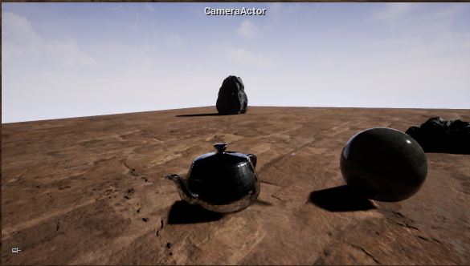
3D concepts & defined terms
Coordinate Spaces: screen space
Finally the viewport transform takes the projected objects from normalized device coordinates to the screen space CS.

Slide 22
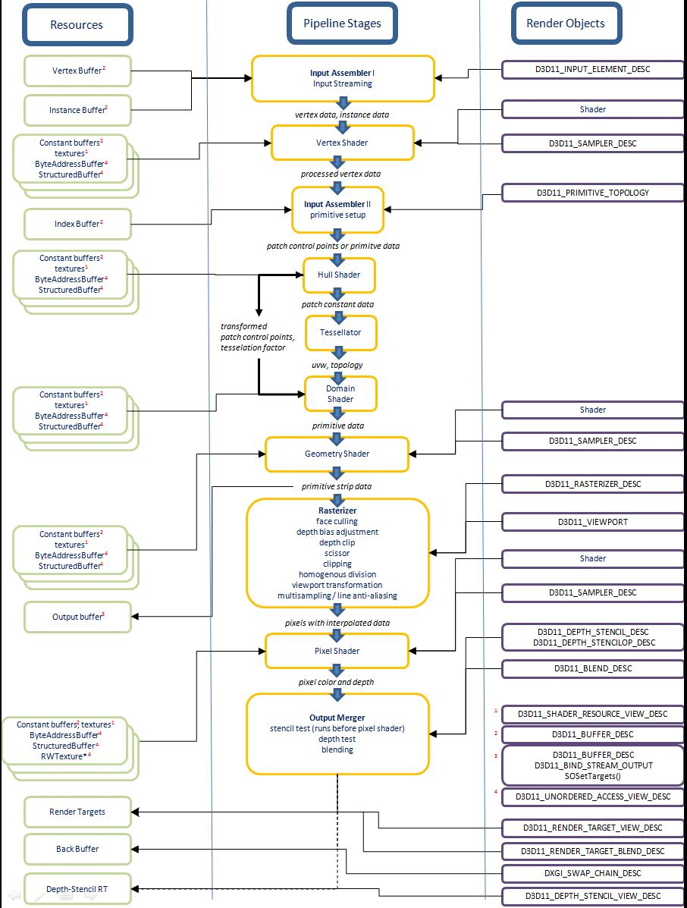
Part II: The Direct3D 11 Pipeline

Slide 23
Direct3D 11 pipeline overview
Memory Resources (Buffers, Constant Buffers, 1D-/2D-/3D-Textures, Texture Arrays)
Render Targets
Stream Output (SO)
Input Assembler (IA)
Geometry Shader (GS)
Output Merger (OM)
Vertex Shader (VS)
Hull Shader (HS)
Tesselator (TS)
Domain Shader (DS)
Rasterizer (RS)
Pixel Shader (PS)
Fixed
Unordered Access Resources (Read/Write from any shader stage from Direct3D 11.1 on)
Prog.

Slide 24
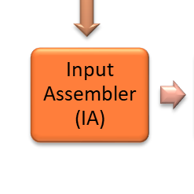
Pipeline stages in detail
Input Assembler stage (IA) – fixed stage
The IA stage reads vertex data provided via one or more vertex buffers and optionally index buffers.
The main task of the IA stage is to assemble the input vertex data to primitive types like lines, triangles, line lists or triangle strips.
The application needs to specify the input layout (=memory layout) of the vertex data as well as the primitive topology that shall be used for primitive assembly (e.g. triangle list).
The data enters the IA stage via so-called input slots which are used to assign or bind buffer objects.

Slide 25
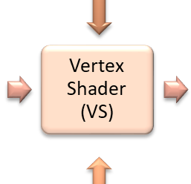
Pipeline stages in detail
Vertex Shader stage (VS) – programmable stage
The VS stage allows per-vertex operations on the data provided by the IA stage.
The operations target to manipulate the vertex attributes like position, color, normal vector or texture coordinates.
A typical task executed in vertex shaders is to transform vertex positions into clip space via multiplication with the combined world-view-projection matrix.
The VS can also be used to do per-vertex lighting calculations (→ Gouraud shading).
It is mandatory to provide a vertex shader program to the pipeline. Otherwise the pipeline would not be operable.

Slide 26
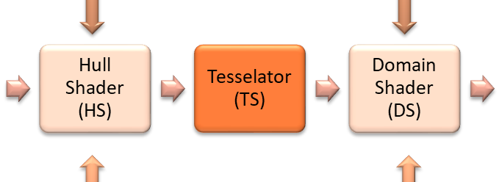
Pipeline stages in detail
Tesselation stages (HS, TS, DS)
The tesselation stages are new with Direct3D 11. They are used in combination to generate more detailed surfaces from low-poly meshes on-the-fly during pipeline execution.
Hull shader and domain shader are programmable. The tesselator stage is fixed.
The use of the tesselation stages is optional. They are mostly used in game development to save storage space on the geometry side or to control level of detail (LOD) depending from the distance of meshes from the camera.

Slide 27
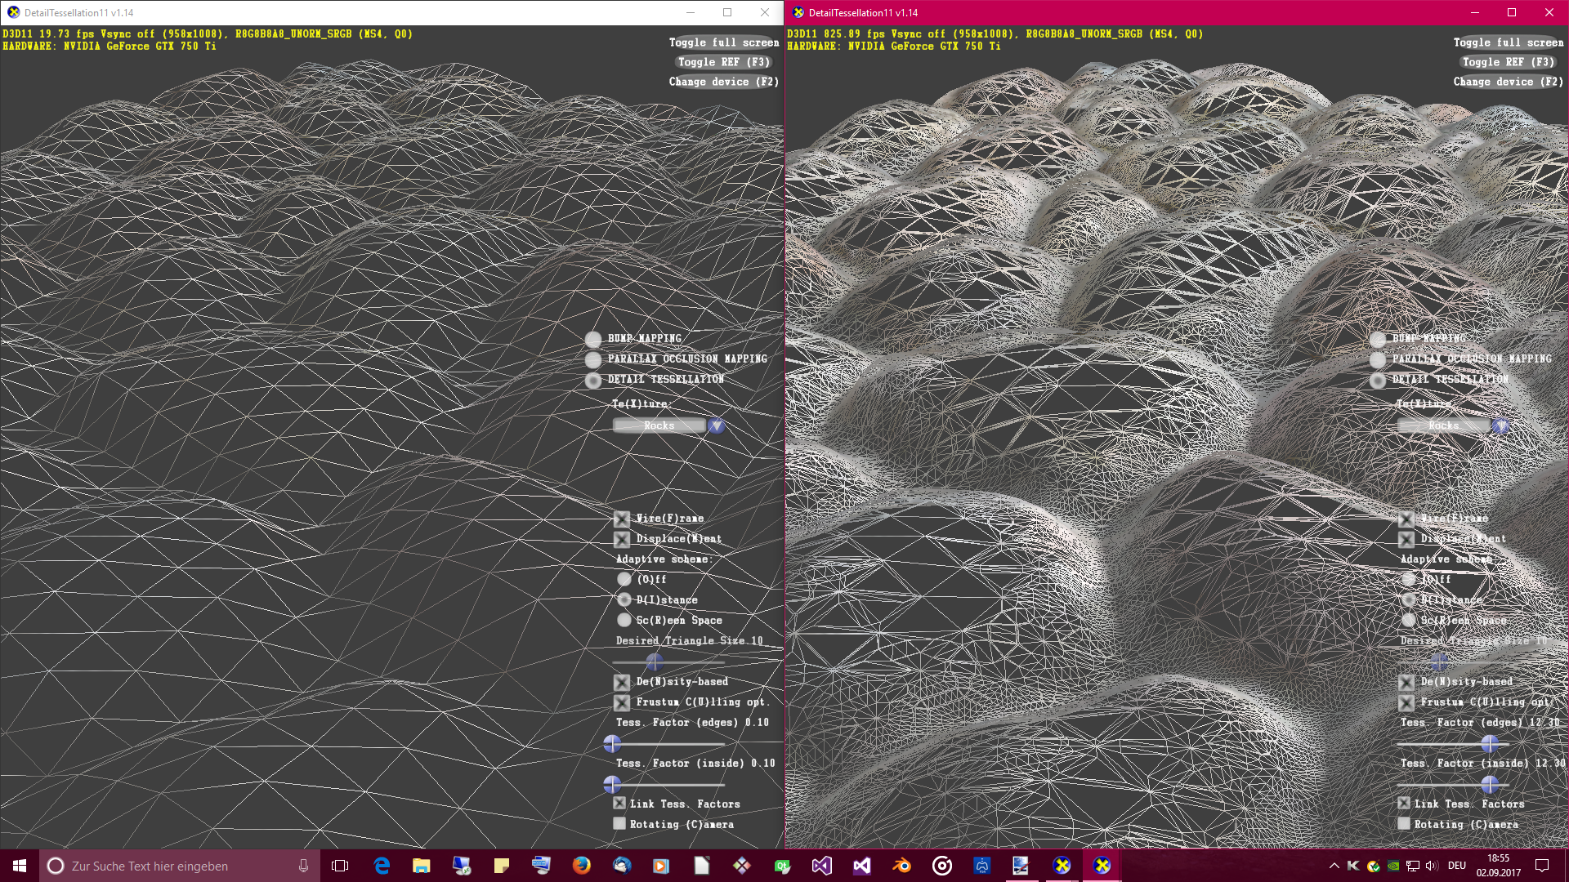
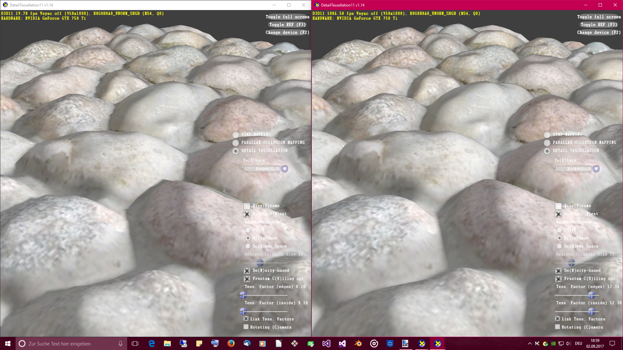
Pipeline stages in detail
Tesselation example

Slide 28
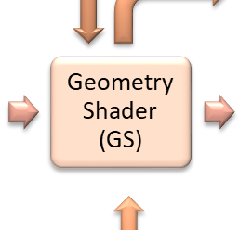
Pipeline stages in detail
Geometry Shader stage (GS) – programmable stage
The GS stage gets a single geometric primitive as input (e.g. vertex or triangle) and is able to either discard this primitive or transform it into a different geometric primitive.
The GS can also be used to generate completely new primitives.
The GS is an optional shader stage. It was introduced with Direct3D 10.
A typical use case is a particle system (used for rendering fire or smoke effects): the GS produces a quad from a single vertex position, which is then used as proxy geometry for 2D sprites (see next slide).

Slide 29
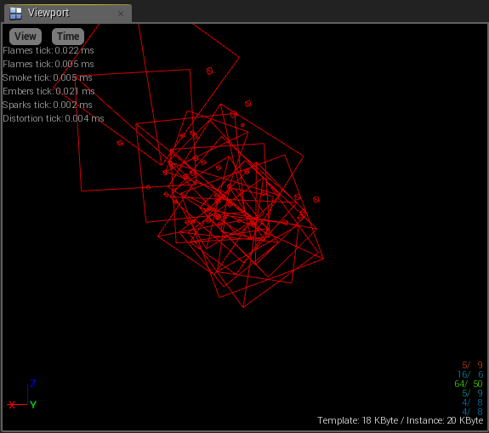
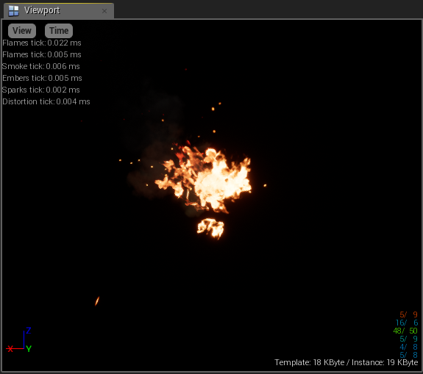
Pipeline stages in detail
Geometry Shader example: particle system

Slide 30
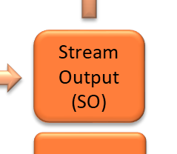
Pipeline stages in detail
Stream Output stage (SO) – fixed stage
The SO stage is used to output geometry data from the Geometry Shader into vertex buffers, to feed them back to the pipeline for re-use.
It was also introduced with Direct3D 10, together with the GS.
The SO stage is also optional and can only be used in combination with the GS.
Again, a good example for using the SO stage is rendering a particle system. The vertex data of the particle quads is re-passed to the pipeline and within the GS, the primitives are discarded if they are marked for termination.

Slide 31
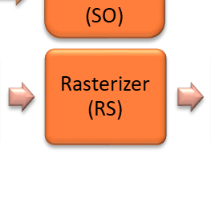
Pipeline stages in detail
Rasterizer stage (RS) – fixed stage
The RS stage is the last pipeline stage before pixel processing takes place. It’s main task is to convert vector graphics to raster graphics (pixels).
The RS stage performs the following jobs:
View frustum clipping
Back-face or front-face culling depending on rasterizer state
Early depth and stencil tests
Perspective divide (convert clip-space to normalized device coordinates)
Viewport mapping
Interpolating of all vertex attributes across each primitive face

Slide 32
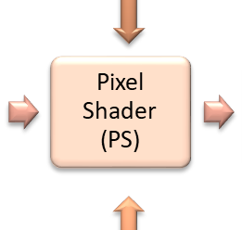
Pipeline stages in detail
Pixel Shader stage (PS) – programmable stage
The PS stage is the final programmable stage. It performs per-pixel operations to calculate the final color of each pixel.
All interpolated vertex attributes provided by the RS stage can be used for pixel shader operations, but the shader has to emit only a final color.
Typical tasks are per-pixel lighting calculations applying a specific lighting model (e.g. Phong shading) or image post-processing effects.
The PS is invoked once for each pixel of a primitive face.
Like the VS, the PS is mandatory for the pipeline operation.
Note: in OpenGL the pixel shader is called fragment shader.

Slide 33
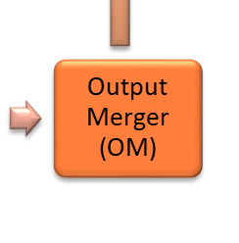
Pipeline stages in detail
Output Merger stage (OM) – fixed stage
The OM combines the results of the pixel shader with potential already available content of the bound render target to the final image.
The behaviour of the OM stage can be influenced via blend state objects (e.g. for alpha blending scenarios) or depth-stencil state objects.
The render target is typically the back-buffer of the DXGI swap-chain or a render target texture.
It is possible to work with multiple render targets (MRT) simultaneously. In Direct3D 11 the maximum allowed number of RTs is eight.

Slide 34
DirectCompute
Compute Shader stage (CS) – programmable stage
The CS stage (a.k.a. DirectCompute pipeline) is intended to be used for GPGPU tasks. It was introduced with Direct3D 11.
Its usage is optional and it can be used in combination with the rendering pipeline.
Typical usage is image post-processing, physics simulation or AI calculation.
From the execution model point of view it is comparable to the CUDA API of Nvidia.
Memory Resources
Compute Shader (CS)
Unordered Access Resources

Slide 35
D3D11 API naming conventions
Some hints on the Direct3D 11 API naming conventions
Once D3D11 is initialized, you work mainly with two interfaces of the API set:
ID3D11Device → create/manage resources
ID3D11DeviceContext → invoke rendering commands & set state objects
ID3D11DeviceContext APIs, which interact with pipeline stages, are prefixed with two letter acronyms as you have seen in the previous slides. Examples:
void IASetInputLayout( .. )
void VSSetShader( .. )
void PSSetSamplers( .. )
void OMSetRenderTargets( .. )

Slide 36
D3D11 API naming conventions
Direct3D 11.x releases
Since the introduction of Direct3D 11 in 2009, Microsoft released several version updates up to the current release 11.5 (Windows 10 creators update, spring 2017).
Using the updated version beginning with version 11.1, you have to initialize dedicated device interfaces with update postfix. Example:
Version 11.1: → ID3D11Device1, ID3D11DeviceContext1
Version 11.2: → ID3D11Device2, ID3D11DeviceContext2
And so on …
Each update version is also represented with a respective feature level (see later).

Slide 37
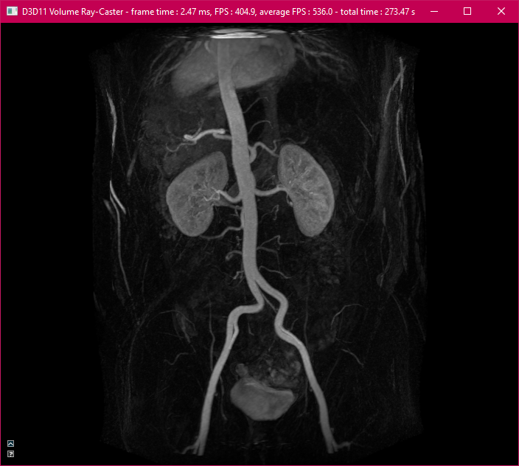
Part III: GPU Ray-Casting

Slide 38
Intro to the demo ray-caster
Features of the D3D11 demo ray-caster
The demo to this presentation implements a 3D volume ray-caster based on the Direct3D 11.0 API.
The rendering mode defaults to an interactive 3D MIP visualization.
The approach for the ray-casting procedure is based on the publication of Krüger-Westermann (see later for details).
The loaded dataset is presented either with auto-rotation or can be rotated manually via trackball control.
Four default datasets are provided for demonstration (2 x CT and 2 x MR), which can be switched on-the-fly during rendering.

Slide 39
Intro to the demo ray-caster
Settings of the D3D11 demo ray-caster (I)
Rendering
Wireframe Mode on/off (default)
Disable Culling back-face culling disabled/enabled (default)
Render Mode
0 3D MIP (default)
1 Front-Faces (= ray entry position)
2 Back-Faces (=ray exit position)
3 Ray Direction (= ray direction vectors)
Camera Distance camera z-position (in LHS)

Slide 40
Intro to the demo ray-caster
Settings of the D3D11 demo ray-caster (II)
Ray-Casting
Sampling Step Size sampling step size related to bounding box
Maximum Samples per Ray max. samples per ray per single pixel to calculate
Animation
Animate on (default)/off
Animation Speed speed factor for auto-rotation speed
Target Frame-Rate (FPS) max. render frame-rate in frames per second (FPS)
Lock to Target Frame-Rate on/off (default) – lock the renderer to max. FPS

Slide 41
Intro to the demo ray-caster
Settings of the D3D11 demo ray-caster (III)
Animation (continued)
Trackball control manual rotation (works only if Animate is off!)
Rotate X auto-rotation around x axis on (default)/off
Rotate Y auto-rotation around y axis on (default)/off
Rotate Z auto-rotation around z axis on/off (default)
Dataset
Load one of the four demo datasets with single click

Slide 42
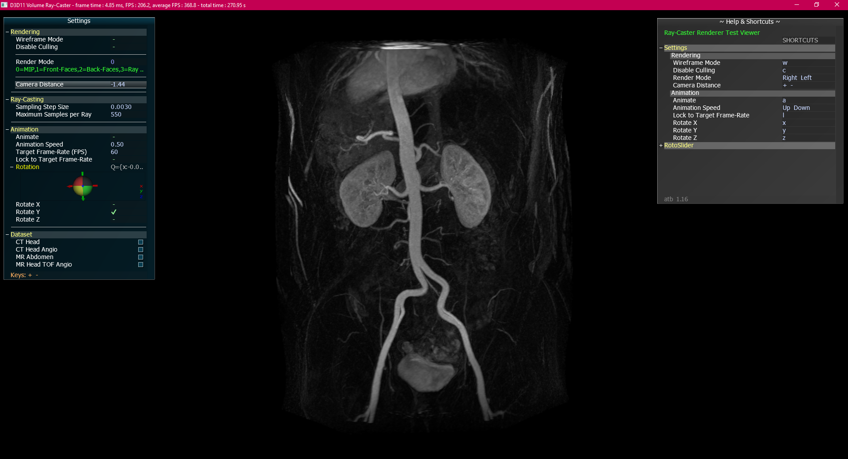
Intro to the demo ray-caster

Slide 43
Intro to the demo ray-caster
How does ray-casting work?
A ray is casted from the view-point through the 2D view-plane for each pixel of this plane.
For each ray an intersection test with the bounding-box of the volume is done.
If the ray hits the box, resampling along the ray within the volume bounding-box is performed.
Depending on the intended rendering mode, shading and compositing of the samples along the ray is performed.
For 3D MIP we simply store the maximum intensity value for 2D projection.

Slide 44
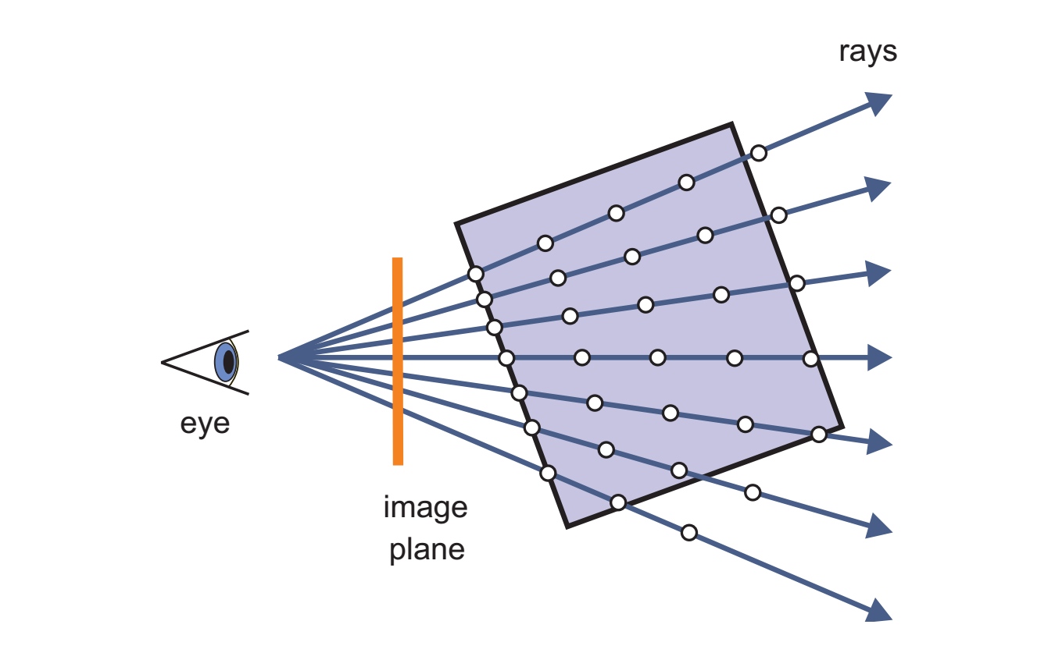
Intro to the demo ray-caster
How does ray-casting work?
Image source: Real-Time Volume Graphics, ISBN: 1-56881-266-3

Slide 45
Krüger-Westermann approach
Instead of performing the ray-box intersection test for each casted ray, this optimized setup does the following to produce the sampling rays:
Render the front faces of the volume bounding-box into a 2D texture.
Then switch on front-face culling and render the back faces of the volume bounding-box into a further 2D texture.
The front-face texture represents the ray entry positions, the back-face texture holds the ray exit positions in normalized 3D texture coordinates from (0, 0, 0) to (1, 1, 1).
In the ray casting pixel shader it is now very simple to calculate the ray direction. Simply subtract the entry position from the exit position to get the ray.

Slide 46
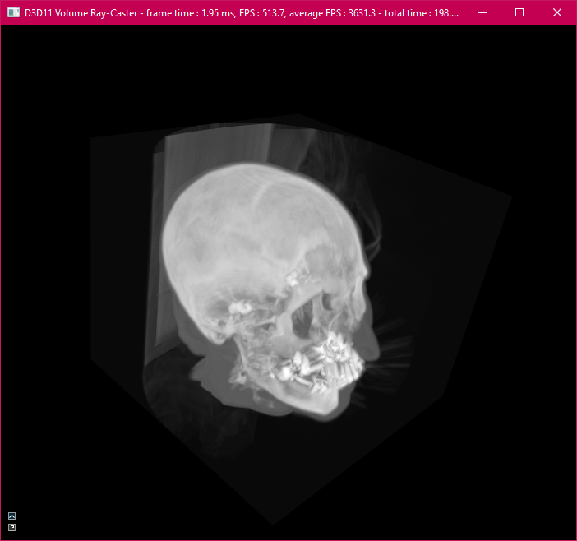
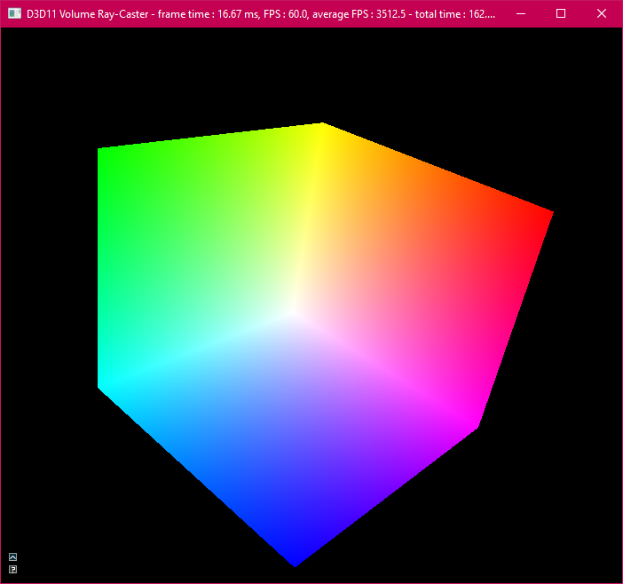
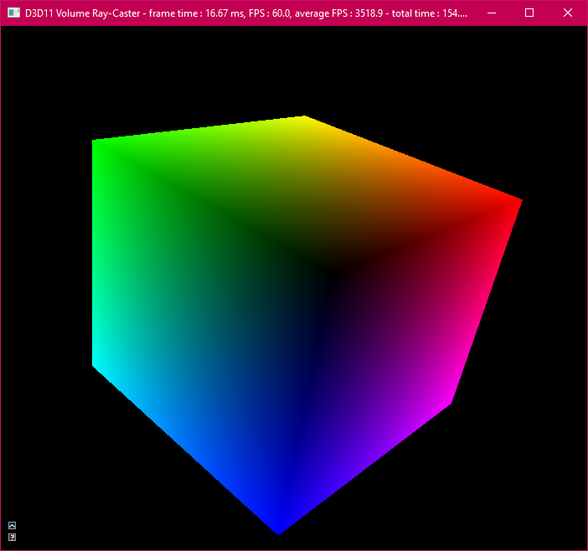
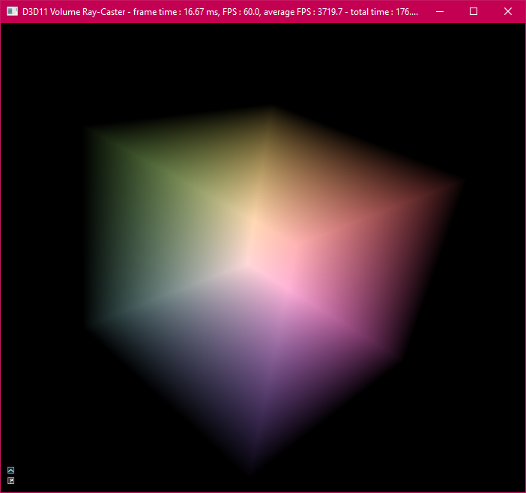
Krüger-Westermann approach
-
=
Ray exit positions
Ray entry positions
Ray direction vectors

Slide 47
Transform setup in the demo
Geometry setup of the bounding cube
The bounding cube is initialized as unit-cube in the range (-0.5, -0.5, -0.5) to (0.5, 0.5, 0.5).
The origin of local space is the center of the cube: (0.0, 0.0, 0.0).
The center is the pivot point for rotations.
Each of the six faces of the cube is made of two triangles.
The vertex definition (index) winding order of the triangles is clock-wise (CW) to mark the face as front-face in a LHS coordinate system.
We use an index-buffer to avoid duplicate definition of adjacent vertices.

Slide 48
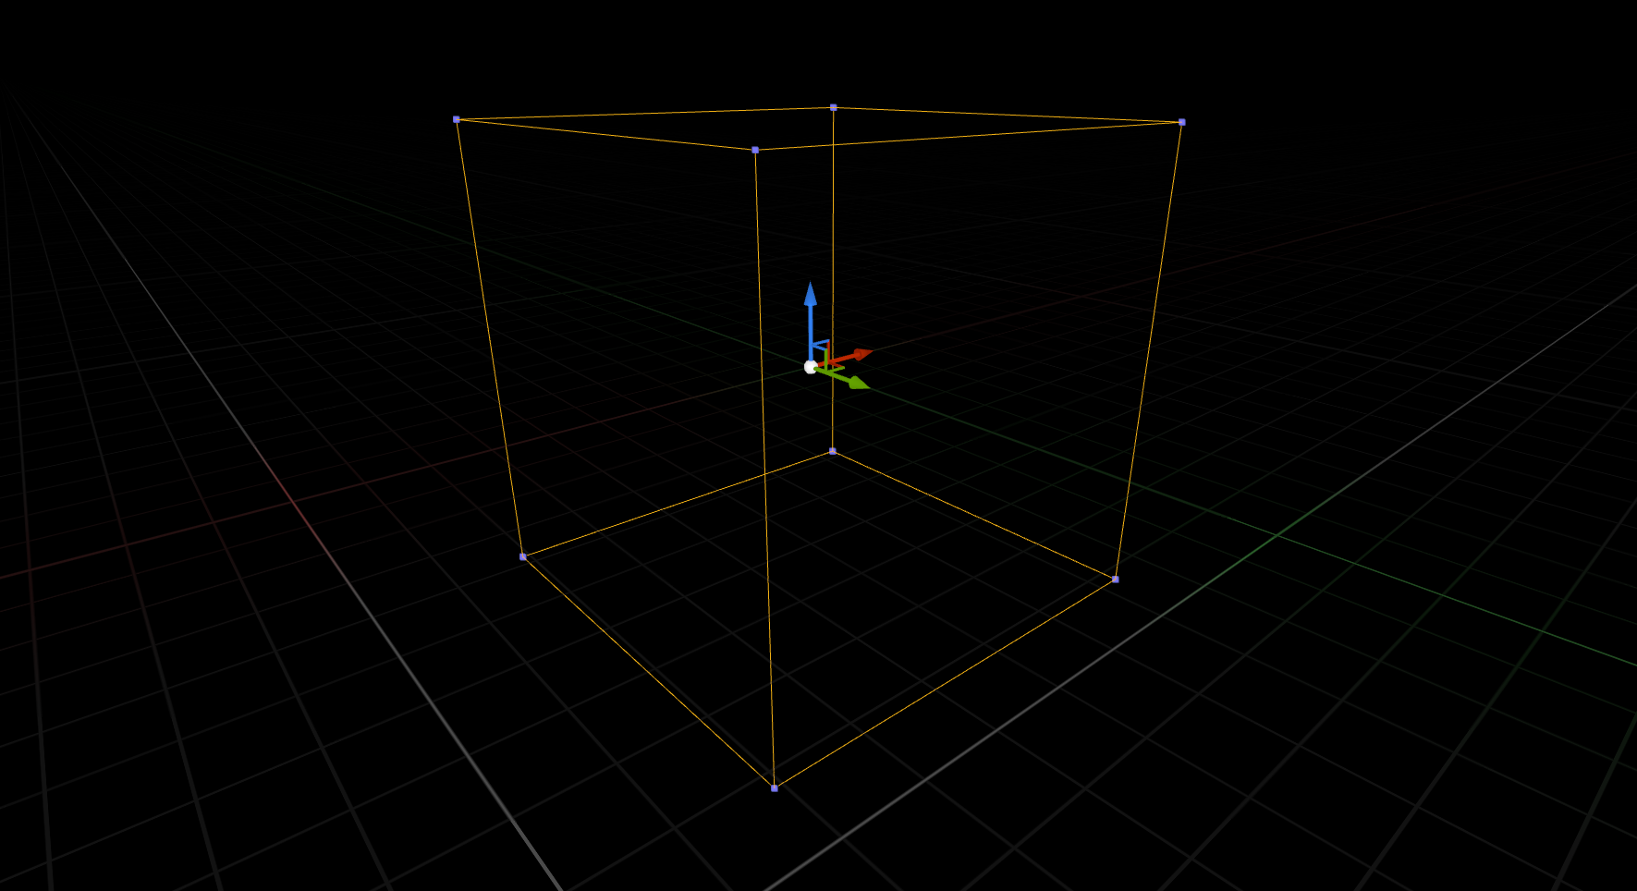
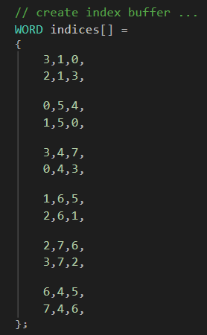
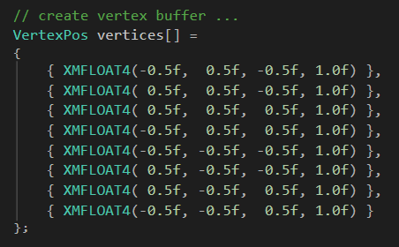
Transform setup in the demo
Bounding Cube – geometry setup using vertex- and index-buffer
V0
V3
V2
(0.5,0.5,0.5)
V1
Y
Z
X
Face Normal Vec
V7
V4
V6
(-0.5,-0.5,-0.5)
V5

Slide 49
Transform setup in the demo
Scene setup
The bounding cube is scaled to the geometric boundaries of the loaded volume dataset (→ correct mapping of anisotropic volumes).
The cube is initially transformed to the world space with mapping its local origin to the world space origin.
Rotations around X-, Y- and Z-axis are kept in a separated rotation matrix to smoothly interoperate with the rotation-quaternion of the trackball control.
The camera is located on the negative Z-axis with initial position (0.0, 0.0, -3.0).
It looks down the positive Z direction to the world space origin (Look-At pos.).

Slide 50
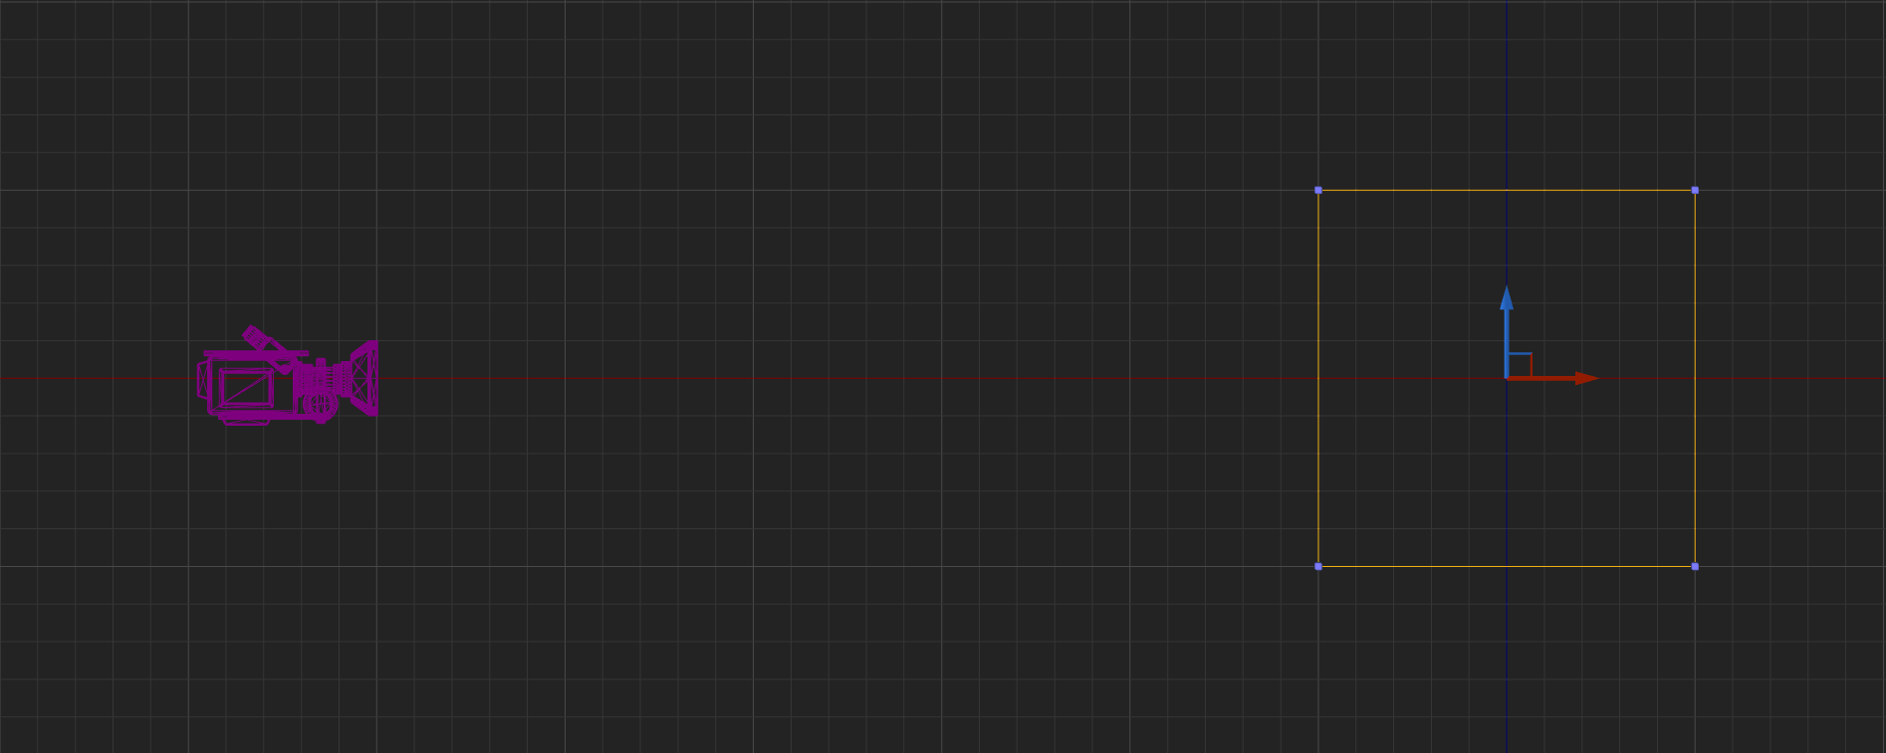
Transform setup in the demo
Scene setup (Y-Z plane view in X=0.0)
camera distance (variable)
Y
Z
(0.0,0.0,0.0)
(0.0,0.0,-3.0)

Slide 51
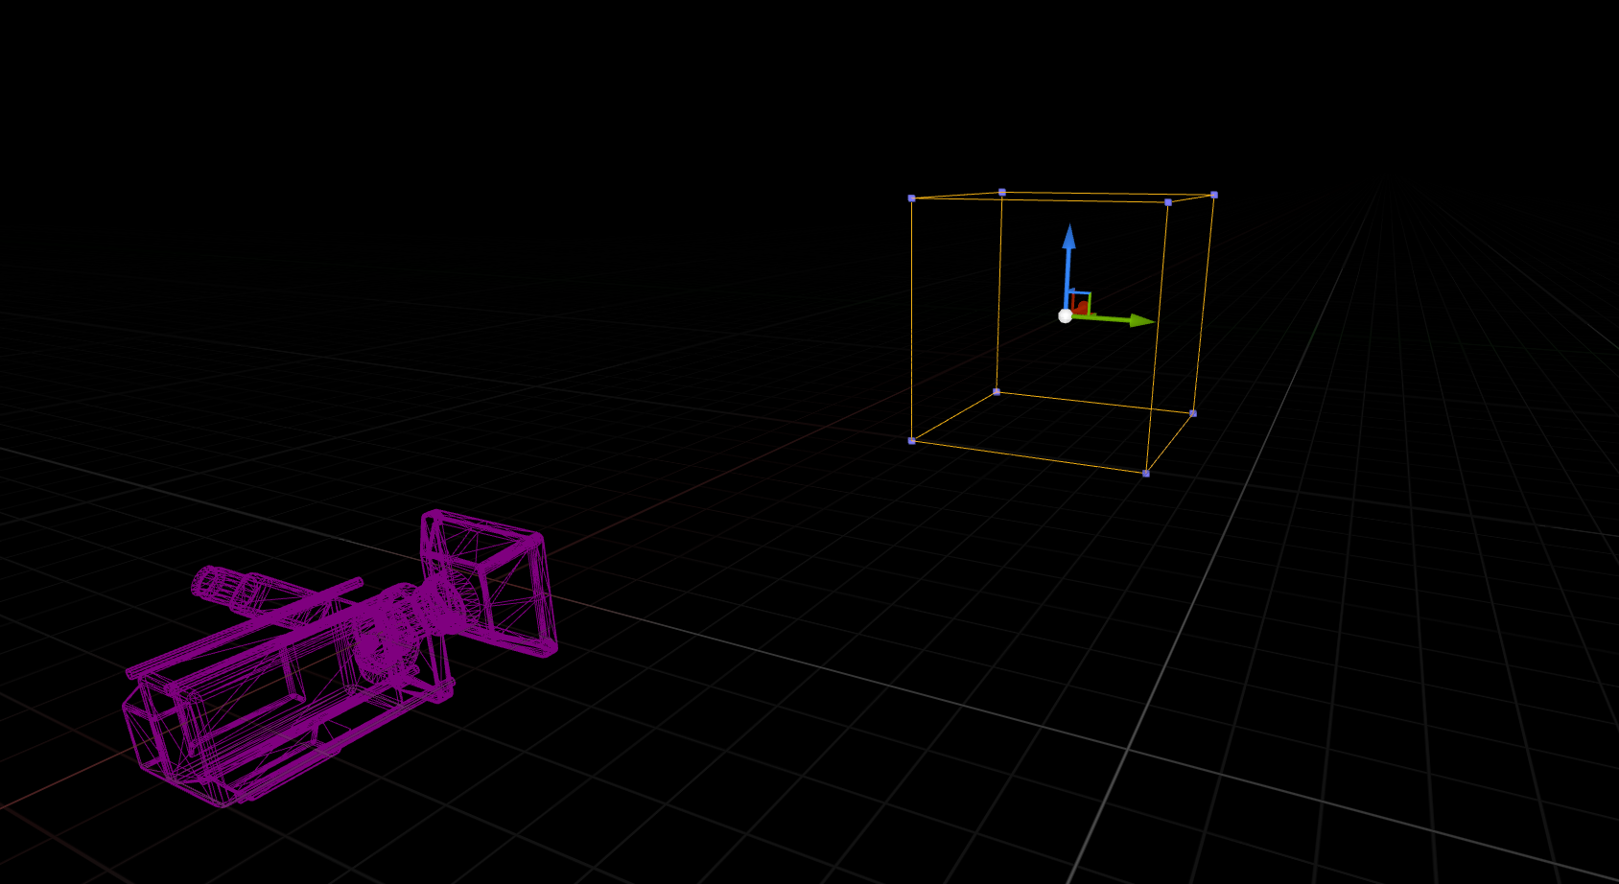
Transform setup in the demo
Scene setup (perspective view)

Slide 52
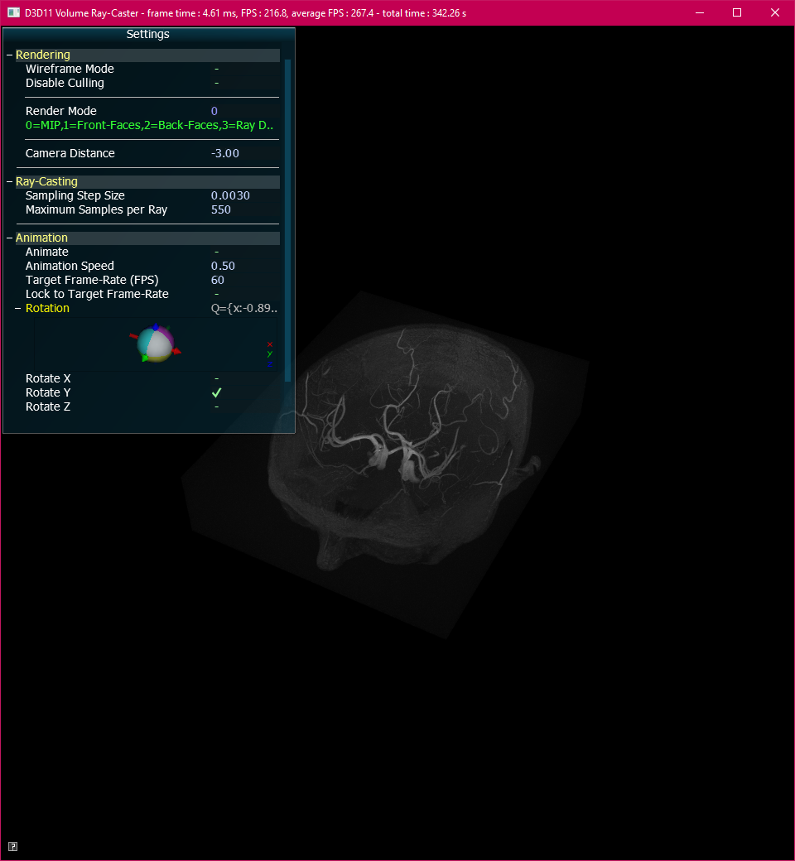
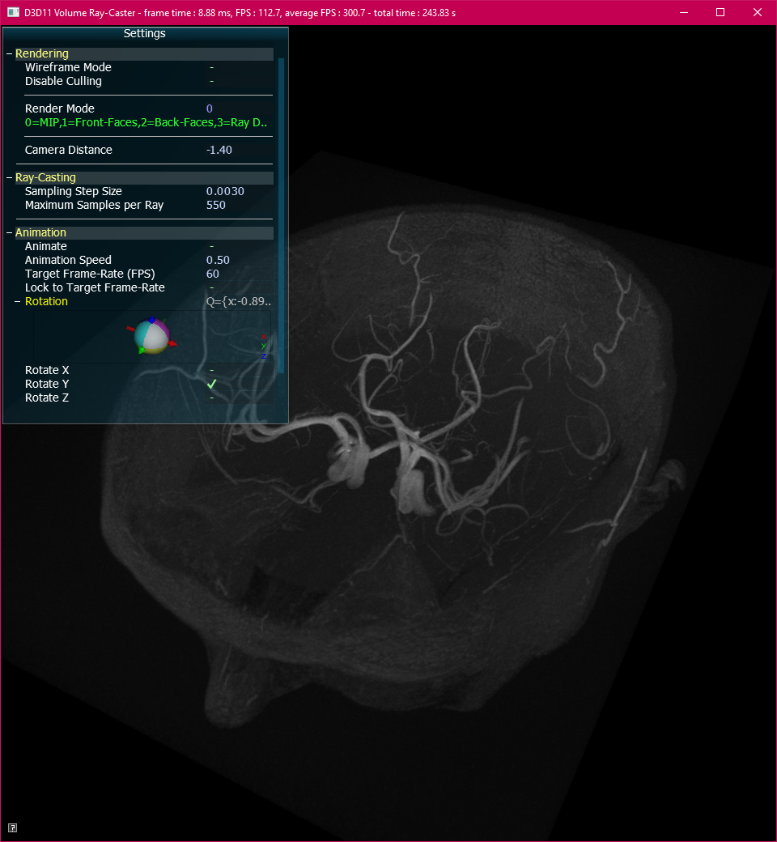
Transform setup in the demo
Modifying camera distance == Zooming in 3D
Camera Distance = -3.0
Camera Distance = -1.4

